Slide 1
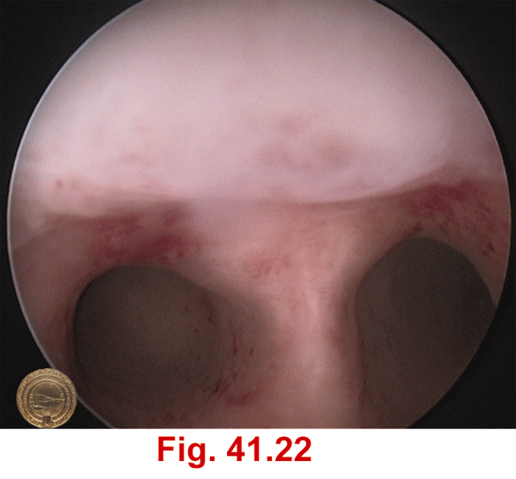
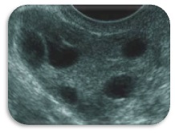
INVESTIGATING THE INFERTILE FEMALE
WEBINAR IFS
10TH JAN 2015
UNICHEM

Slide 2
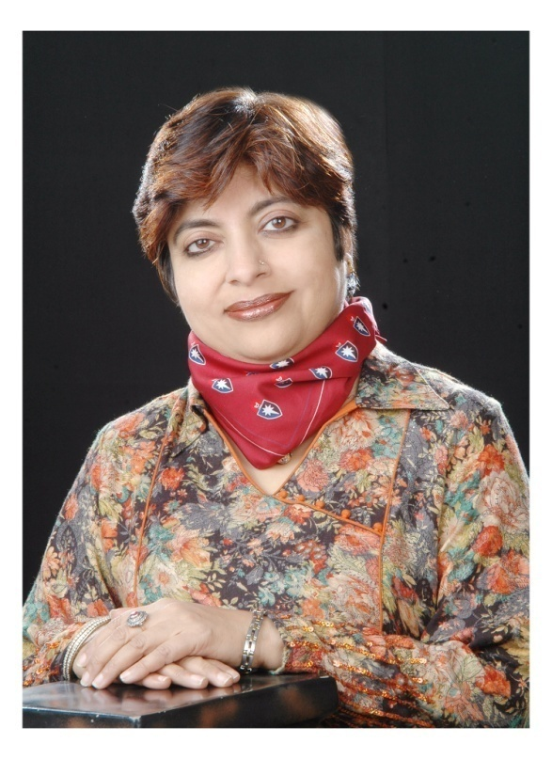
Dr. Mala Arora
FRCOG (UK), FICOG,FICMCH
VICE CHAIRPERSON ICOG
Director NOBLE IVF Centre
Editor in chief – WORLD CLINICS IN OB/GYN (jaypee) – 5 vol
Editor of book Recurrent pregnancy Loss 2nd Edition
Editor of book – First Trimester of pregnancy 2014
Editor of book – Hyperhomocysteinemia & Pregnancy
Co Editor of book –Clinical Essays for MRCOG
(Recommended reading list for MRCOG (RCOG UK)
Associate Editor –International Journal for Infertility
& Fetal Medicine
Peer Reviewer International Journal of Human Reproductive Sciences
Contributed 20 book chapters and delivered 200 lectures

Slide 3
IS SHE OVULATING ? ARE HER TUBES PATENT ?
ASK YOUR SELF THESE TWO BASIC QUESTIONS

Slide 4
IS SHE OVULATING ? YES
REGULAR PERIODS
NO STIGMA OF PCOD e.g.HIRSUTISM
MIDCYCLE CERVICAL MUCOUS INCREASE
MIDCYCLE PAIN / SPOTTING
DYSMENORRHEA
LH DETECTION KIT / TEMP CHARTING
FOLLICULAR STUDY
DAY 21 PROGESTERONE > 10 NG/ML

Slide 5
IS SHE OVULATING ? NO
IRREGULAR CYCLES >35 DAYS
ONLY WITHDRAWAL BLEEDS
NO DYSMENORRHEA
FEATURES OF PCOD – HIRSUTISM / OBESITY
STRESS PRONE TYPE A PERSONALITY
NO LH SURGE / TEMP RISE
FOLLICULAR STUDY
DAY 21 PROGESTERONE < 5 ng/ml

Slide 6
ENDOCRINE DISORDERS
PCOD – HYPERANDROGENEMIA
PCOD - HYPERINSULINEMIA
HYPERPROLACTINEMIA > 30 ng/ml
HYPO /HYPERTHYROIDISM
CONGENITAL ADRENAL HYPERPLASIA
HYPOGONADOTROPIC HYPOGONADISM
PREMATURE OVARIAN FAILURE
ADDISONS / CUSHINGS / DIABETES …..

Slide 7
ENDOCRINE INVESTIGATIONS
SERUM PROLACTIN
THYROID FUNCTION TEST
DAY 2 FSH / LH / ESTRADIOL / PROG
AMH / INHIBIN
FREE TESTOSTERONE / DHEAS / TOTAL TEST
17 HYDROXY PROGESTERONE
FASTING / 2 HR PP INSULIN
SERUM CORTISOL / ACTH STIMULATION TEST

Slide 8
FIRST CYCLE – DAY 2 OF PERIOD
BASELINE SCAN – ANTRAL FOLLICLE COUNT
- CYSTS / CORPUS LUTEUM
BASELINE FSH /LH / ESTRADIOL / PROG
THYROID FUNCTION TEST / PROLACTIN
DAY 8-14 – FOLLICULAR STUDY / LH KIT /
CERVICAL MUCOUS / TEMP
POST COITAL TEST
DAY 21 SERUM PROGESTERONE

Slide 9
SEMEN ANALYSIS
3 DAYS ABSTINENCE
MASTURBATORY SPECIMEN
STERILE CONTAINER - CULTURE

Slide 10
HPO AXIS
WHO CLASS 1
WHO CLASS 2
WHO CLASS 3

Slide 11
WHO CLASSIFICATION
Group 1 Hypothalamic pituitary failure
(hypogonadotrophic hypogonadism)
Group 2 Hypothalamic pituitary dysfunction
(Polycystic Ovarian Disease)
Group 3 Ovarian failure
(Premature Ovarian Failure)

Slide 12
HPO AXIS
CLOMIPIHENE CHALLANGE TEST
50 mg CC DAY 2-7
FSH / LH / ESTRADIOL ON DAY 8-10
FSH > 10 – PREMATURE OVARIAN FAILURE
LH > 10 - PREMATURE LH SURGE
FSH / LH < 1.0 – HYPOGONADOTROPIC HYPOGONADISM

Slide 13
HPO AXIS – GAST TEST
GONADOTROPIN STIMULATION TEST
BASELINE FSH / LH - IF LOW
1 mg of TRIPTORELIN S/C
FSH /LH AFTER 2 DAYS
IF RISE IN VALUE – INTACT PITUITARY
HYPOTHALAMIC DISORDER

Slide 14
HPO AXIS – EFFORT TEST EXOGENOUS FSH OVARIAN RESERVE
GIVE 75 IU OF HMG / FSH FROM DAY 2 OR 3
MONITOR FOLLICULAR RESPONSE FROM DAY 8 OF CYCLE
IF NO RESPONSE – DO ESTRADIOL / LH LEVEL
INCREASE DOSE OF HMG
IF NO MATURE FOLLICLE DEVELOPS- NO OVARIAN RESPONSE
IF OVARIAN FOLLICLE DEVELOPS
GIVE HCG WHEN FOLLICLE 16-18
TIMED INTERCOURSE / LUTEAL SUPPORT

Slide 15
ARE HER TUBES PATENT ?

Slide 16
ARE HER TUBES PATENT ?
PREVIOUS D&C / EB / DELIVERY
FEVER POST PARTUM / OTHERWISE
CONTACT WITH A CASE OF TB
UNEXPLAINED WEIGHT LOSS / ANAEMIA
ABDOMINAL PAIN
SCANTY PERIODS
THIN ENDOMETRIUM / HYDROSALPINX
MYOMAS

Slide 17
HYSTEROSALPINGOGRAM
TUBAL FILLING
TUBAL SPILL
AMPULLARY FOLDS
HYDROSALPINX

Slide 18
IF HSG DOUBTFUL / BLOCKED
LAPAROSCOPY
HYSTEROSCOPY
ENDOMETRIAL BIOPSY – HPE / TB PCR

