Slide 1
Evaluation of tubes and Endometrium.
Dr Neeta Singh
Additional Professor,
Department of Obstetrics & Gynaecology All india Institute Of Medical Sciences,New Delhi

Slide 2
Dr.Neeta Singh,MBBS, MD, FICOG, FIMSA, FICMCH
Credited the first IVF baby of AIIMS
Addl.Professor & Faculty in charge for IVF Facility Department of Obstetrics & Gynecology
All India Institute of Medical Sciences, New Delhi
Joint Secretary AOGD (2013-14)
Chairperson Endometriosis Committee of AOGD
Governing Council member of Indian Fertility Society
Fellowship in IVF from Germany &USA
ICRETT Fellow UK
WHO Fellow in Reproductive Health
Awarded FOGSI Imaging Science Award 1998
Awarded FOGSI Young Scientist Award 2001
Main area of interest Infertility & IVF, Reproductive Endocrinology
Published more than 100 Papers in Indexed peer reviewed Journals, contributed 13 chapters in different text books
Delivered many Guest lectures and presented more than 100 papers at National & International conferences.
Member of many prestigious International and National organizations

Slide 3
Fallopian tubes..
The Fallopian tube plays an essential role in tubal transport of both gametes and embryos and in early embryogenesis.
The tube undergoes cyclical changes in morphology and ciliary activity in response to ovarian hormones.
There is emerging evidence that muscle contractions may play a role in mixing of secretions rather than in propulsion of gametes and embryos.

Slide 4
The tubal factor…..
25-30% of female infertility is contributed by the tubal disease.
Acute salpingitis is most common
-1 episode: 11% risk of infertility
-2 episode : 23% risk of infertility
-3 episode: 54% risk of infertility
Tubal obstruction: can be
-Proximal, Distal, Entire segment

Slide 5
When should one start evaluating for tubes?
History of MTP,Ectopic pregnancy, ruptured Appendix
History of infections,TB,PID etc
History of Secondary infertility
Long duration infertility
Short infertility where age of the couple is more

Slide 6
How to evaluate the tubal factor?
Hystero-salpingography (HSG)
Saline Sono-salpingography(SSG)
HYCOSY
Laparoscopy

Slide 7
Who should be offered Hystero-salpingography (HSG)
Women who are not known to have co morbidities (such as PID, previous ectopic pregnancy or endometriosis) should be offered (HSG) to screen for tubal occlusion .
HSG is a reliable test for ruling out tubal occlusion, is less invasive & expansive and makes more efficient use of resources than laparoscopy.
Nice Guidelines 2004

Slide 8
Hystero-salpingography
Advantages:
images uterine cavity,
reveals internal architecture of tubes,
no requirement of GA
Disadvantages:
painful,
radiation exposure,
risk of infectious complication,
cant tell about adhesion, endometriosis or other ovarian pathology
Cochrane database systemic review 2005

Slide 9
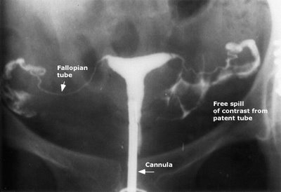
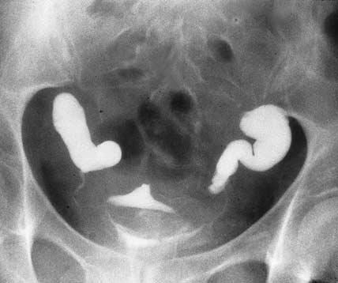
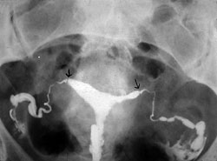

Slide 10
HSG contd.
Analgesia: NSAIDS half an hour before procedure
Antibiotics: given if distal tubal disease is suspected
ACOG recommends antibiotics if HSG demonstrate dilated fallopian tubes.
( Doxycycline 100mg orally twice daily for five days)

Slide 11
Problems during the procedure
Leaking of contrast media: larger cannulae tip or a balloon catheter should be used.
Stenotic Os: pediatric Foleys catheter or use of dilators
Inadequate visualization of cavity: outward traction on cervix
Intravasation: avoiding excessive pressure during contrast injection
External artifact( stool in colon): moving the patient to one side can distinguish intrauterine from extra uterine structure.

Slide 12
Diagnostic accuracy
False positive( patency that is not real)
False negative( obstruction that are not real)
When HSG reveals obstruction, there are high chance(60%) that tubes are patent
When HSG demonstrate patency, there are little chance that tubes are occluded

Slide 13
2. Sono-salpingography SSG
Advantage :USG based test so can be done with baseline scan. Thus saving time
uterine cavity can be visualized
myoma,polys & adhesions can be diagnosed
Peritoneal adhesions can be diagnosed
No radiation exposure
Disadvantage:
Can not tell whether one or both tubes are patent
Not enough evidence to replace HSG at present
Nice Guidelines 2004

Slide 14
3.Hycosy
Where appropriate expertise is available, screening for tubal occlusion using ultrasonography should be considered because it is an effective alternative to hysterosalpingography for women who are not known to have co morbidities.
Nice Guidelines 2013

Slide 15
4. laparoscopy
Gold standard.
Panoramic view of pelvic anatomy, tubes, Ovaries and peritoneal surface
Can diagnose early Endometriosis, spots can be biopsied
Can identify milder degrees of distal tubal obstruction
( Fimbrial agglutination, Phimosis).
Opportunity to treat at the same sitting(lysis of filmy adhesion, Fulguration & excision of superficial endometriosis)
Laparoscopy is better predictor of future treatment than HSG( as the information gained is more accurate)

Slide 16
Distal tubal obstruction
Most common:70%
Caused by, Pelvic adhesion or occlusion of Fimbriae
Varies from mild disease(Fimbrial agglutination)
to severe disease(complete tubal obstruction)
Prevents ovum capture

Slide 17
Distal tubal Obstruction
Fimbriolysis: separation of adherent fimbriae
Fimbrioplasty:correction of phimotic but patent ostium
Neo-salpingostomy: reopening of completely obstructed fimbriae
Variables that affect prognosis are:
extent of tubo-ovarian adhesion,
tubal thickness & length
integrity of mucosal architecture

Slide 18
Distal tubal obstruction
Majority of pregnancies in two years of surgery
Young women with mild disease: surgery
Older women with significant disease: IVF
Laparoscopic proximal tubal occlusion, or salpingectomy : improves pregnancy rates with IVF

Slide 19
Proximal tubal obstruction
Prevents sperm from reaching into fallopian tubes( ampullary portion) for fertilization
Most commonly caused by infection, myoma,salpingitis isthimica nodosa or dried mucus
Sometimes misdiagnosed in HSG due to tubal spasm
- can be avoided by slowly injecting the dye
-laparoscopy required for confirmation

Slide 20
Proximal tubal disease
Confirm diagnosis with laparoscopy( 20-40% of diagnosed tubal obstruction on HSG are false)
Proximal tubal cannulation using hysteroscopic or fluoroscopic method
-60-80% patency rates
-20-60% pregnancy rates
Microsurgical segmental tubal resection and anastomosis
in the era of improved ART results is debatable.

Slide 21
Evaluation of Endometrium
The implantation process of the human embryo requires a subtle dialogue between the mother and the embryo. On the maternal side, a so-called receptive endometrium is a prerequisite
(Giudice, 1999).
To our current knowledge, the Endometrium, among many other things, is definitely a fertility-determining factor and the time has come to develop therapeutic concepts through clinical studies.

Slide 22
When should you evaluate Endometrium
A must for every infertile female to have baseline USG to look for Endometrium

Slide 23
How to evaluate the endometrial function
Ideally, a technique to assess Endometrium to predict its receptivity must be easily performable, on-invasive and objective.
These requirements are met by ultrasound measurements of endometrial thickness and its echo pattern.
More sophisticated techniques have been introduced to analyse endometrial function such as endometrial perfusion by endometrial Doppler studies,

Slide 24
Evaluation of the Endometrium by USG
The 2D USG for evaluating endometrial function has been found very useful.
In the proliferative phase, the Endometrium has a hypo echoic texture with a well-defined central line which becomes hyper echoic in secretory phase with no visualization of the central echogenic line
The triple-line pattern at ovulation has been described as a v good prognostic factor for pregnancy in stimulated cycles (Bohrer et al., 1996; Oliveira et al., 1997)
To improve the prognostic value a 3D endometrial volume calculation by ultrasound using special software (Voluson) has been found very useful.

Slide 25
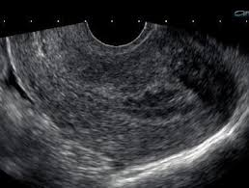
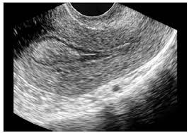

Slide 26
3D Endometrial Volume

Slide 27
Role of Color Doppler in evaluating Endometrium
Adding color to the 2D trans-vaginal sonography adds the functional inputs about the receptivity of the Endometrium .
The very well vascularized Endometrium has enhanced implantation potential due to variety of factors.

Slide 28
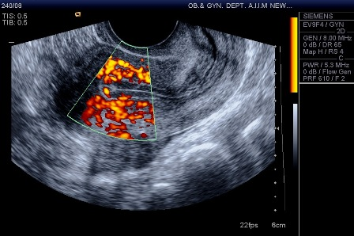
2D Color Doppler

Slide 29
Role of Hysteroscopy in evaluating Endometrium & the cavity
The gold standard
Can be performed in office setting
Dilatation not usually required
Entry should be made under direct vision
Endometrium should be assessed for colour,texture,
vascularity and thickness
Evaluation of cervical canal, endometrial cavity,
endometrial polyp, myoma or adhesion can be done.

Slide 30
Role of Hysteroscopy
The accuracy of both 3D and 4D transvaginal Sonography is fast replacing hysteroscopy being non-invasive.
Hysteroscopy is still the Gold standard for diagnosing endometrial pathologies like myoma,polyp and adhesions.
Hysteroscopy has added therapeutic advantage also

Slide 31
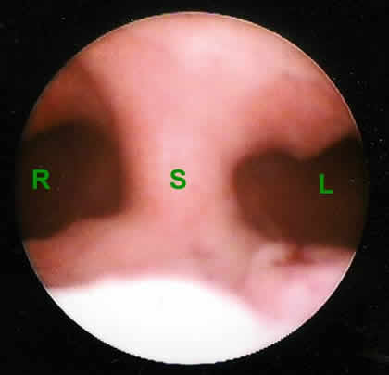
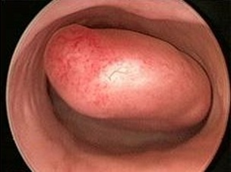
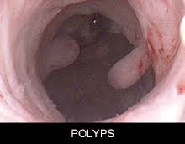

Slide 32
Nice Guidelines 2004
Women should not be offered routine hysteroscopy as part of the initial investigation unless clinically indicated.
because the effectiveness of surgical treatment of uterine abnormalities on improving pregnancy rates has not been established

Slide 33
Take home message
Evaluation of Tubes and Endometrium is of paramount
significance in evaluating female infertility
HSG still is the first line method in young couples with no
relevant past history.
All cornual block must be confirmed by Laparoscopy and
cannulation should be tried in healthy tubes.
Early Laparoscopy should be considered in women with
history of secondary infertility, advanced age ectopic pregnancy, Dysmenorrhoea.

Slide 34
Screening endometrial cavity by Hysteroscopy in every patient is not indicated
Transvaginal Sonography with 3D imaging is fast replacing Hysteroscopy for screening Endometrium and cavity
2D Color Doppler can assist in diagnosing impaired endometrial receptivity.

Slide 35
Thank You

