Slide 1
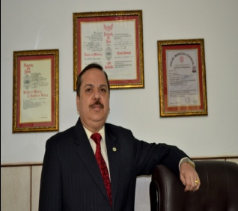
Dr (Brigadier) R K Sharma VSM MD
Director HOD
Institute of Reproductive Medicine and IVF centre
Primus Super Specialty Hospital
Chanakya Puri , New Delhi
Founder director
ART Centre at Army Hospital ( R & R) Delhi and
” Southern Star “ART Centre at Command Hospital (SC),Pune
Advisor ART Program of medical colleges and private centres
Former Gen Secretary IFS
Recipient of Jagdishwari Mishra award FOGSI
Vashisht Seva Medal by President of India
Notes:
1

Slide 2
CLINICAL INVESTIGATIONS
OF
MALE INFERTILITY
Notes:
2

Slide 3
INCIDENCE
Male factor - 40%
Combined (male and female) - 10%.
Notes:
3

Slide 4
SEMEN ANALYSIS
FIRST INVESTIGATION
NON EVASIVE
COST EFFECTIVE
SEMEN PARAMETER /EJACULATORY FUNCTION
Notes:
4

Slide 5
SEMEN ANALYSIS
Two semen samples
Coitus interruptus or silastic condoms devoid of spermatocidal agents
PRECAUTIONS
  48 to 72 hours of abstinence.
  Collected at the laboratory by masturbation in sterile non-toxic container.
  Analyzed within l hour - body temperature.
  To decrease variability, each sample should be collected after the same period of sexual abstinence (2 to 3 days).
Notes:
5

Slide 6
OTHER BASIC INVESTIGATIONS
HIV / HBsAg/ VDRL/HCV
BLOOD GROUP
BLOOD SUGAR
Notes:
6

Slide 7
Normal Values of Semen Variables: WHO Guidelines
 | 1999 | 2010
Volume | 2.0 mL or more | 1.5 ml (1.4–1.7);
pH | 7.2 to 8.0
Sperm concentration | 20 million or more | 15 million per ml (12–16);
Total sperm count | : 40 million or more | 39 million per ejaculate (33–46);
Motility | : 50% or more with forward progression or 25% or more with rapid progression | progressive motility, 32% (31–34); total (progressive + non-progressive) motility, 40% (38–42
Morphology | 30% or more with normal forms | 4.0% (3.0–4.0).
White blood cells | Less than 1 million
Immunobead | MAR<50% bound/adherent
Notes:
7

Slide 8
SEMEN ANALYSIS
NORMAL REPORT
NO SEXUAL DYSFUNCTION – NO MORE INVESTIGATION
WORDS OF CAUTION
  OLD NORMAL REPORT DOES NOT MEAN IT WILL REMAIN NORMAL THROUGH OUT LIFE.
Notes:
8

Slide 9
CAUTION
Laboratory analysis does not predict fertility
Pregnancy is the only irrefutable proof of the sperm's capability to fertilize.
Notes:
9

Slide 10

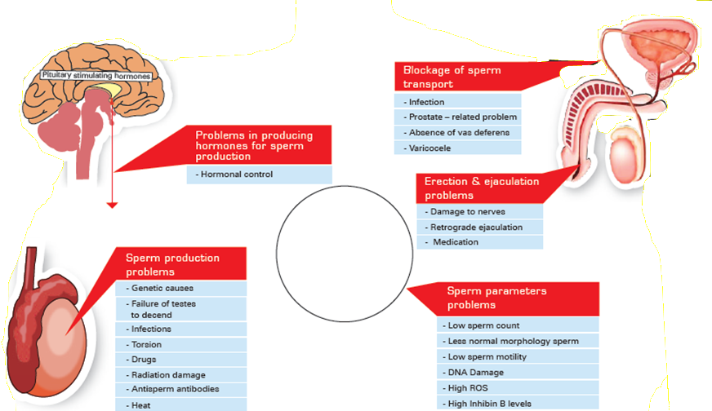
Male infertility CAUSES
MALE INFERTILITY
Need of the hour is “a therapy to improve sperm quality”
Notes:
10

Slide 11
HISTORY
Notes:
11

Slide 12
CHILDHOOD ILLNESSES AND DISORDERS
Cryptorchidism: both unilateral and bilateral
Baseline serum FSH, LH and testosterone levels - normal
30% unilateral and 50% bilateral cryptorchidism have sperm densities < 20 million/mL
Fertility not improved with postpubertal orchidopexy
Notes:
12

Slide 13
TESTICULAR TRAUMA OR UNILATERAL TESTICULAR TORSION
30% to 40% unilateral testicular torsion cases - abnormal semen analysis
CAUSE
  A breakdown in the blood-testis barrier
  Pre-existing spermatogenic defect
  Immunologically mediated.
Notes:
13

Slide 14
BILATERAL MUMPS ORCHITIS
Prepubertal - no effect
Postpubertal-severe testicular damage in 10% of patients.
15-25% mumps can develop orchitis - commonly unilateral
Testicular atrophy - within 1 to 6 months or may take years.
Fewer than one-third of men with bilateral orchitis recover normal semen parameters
Notes:
14

Slide 15
SPERMATOTOXIC LUBRICANTS
K-Y Jelly, Lubifax, Surgilube, Keri Lotion and even saliva - impair sperm motility.
Other lubricants, such as raw egg white, vegetable oil, sunflower oil, peanut oil, and petroleum jelly, do not impair - in vivo sperm motility.
Fore play is better option
Notes:
15

Slide 16
DIABETES MELLITUS OR MULTIPLE SCLEROSIS
Impair
  Potency
  Ejaculation
Notes:
16

Slide 17
CHEMOTHERAPY/ RADIATION
Impaired spermatogenesis.
Patients with testicular cancer are particularly affected.
Notes:
17

Slide 18
HISTORY
BLADDER, PELVIC, OR RETROPERITONEAL SURGERY
  Ejaculatory dysfunction
  Incomplete or retrograde ejaculation
HERNIORRHAPHY
  Iatrogenic vasal injury
Notes:
18

Slide 19
HISTORY
LUTI - scarring of the ductal system e.g., ejaculatory duct stenosis or obstruction- affect fertility.
FEBRILE EPISODE - transiently impairs spermatogenesis
Notes:
19

Slide 20
Medications, Toxins, and Drugs Associated with Male Infertility.
Medications
Androgenic steroids
Antihypertensives
Cancer chemotherapy
H₂ blockers
Ketoconazole
Spironolactone
Sulfasalazine
Nitrofurantoin
Gentamicin
Cyclosporine Erythromycin TetracyclineColchicineAllopurinol
Toxins
Agent Orange
Benzene
Anesthetic gasses
Dibromochloropropane (DBCP)
Lead
Manganese
Other Drugs
Alcohol
Heroin
Marijuana
Methadone
Tobacco
Notes:
20

Slide 21
Exposure to increased scrotal temperature.
Laptop
Avoid the use of saunas and hot tubs.
Notes:
21

Slide 22
SEXUAL DYSFUNCTION
20% of infertile males.
  Decreased sexual drive
  Erectile dysfunction
  Premature ejaculation
  Failure of intromission
Decreasing libido and erectile dysfunction may reflect low serum testosterone levels with an organic cause.
Performance anxiety is also often reported and often abated with reassurance.
Notes:
22

Slide 23
Erection, ejaculation, and orgasm are three distinct, independent, physiological and psychodynamic events which normally occur concurrently in men
COUNSELLING
Notes:
23

Slide 24
EXAMINATION
Notes:
24

Slide 25
LOCAL EXAMINATION
Testicle size-
  length - 4.6 cm
  Width 2.6 cm
  Volume 18.6 mL
Measured using a ruler, caliper, or orchidometer
Prepubertal damage -testes small and firm
Postpubertal damage - testes small and soft.
Notes:
25

Slide 26
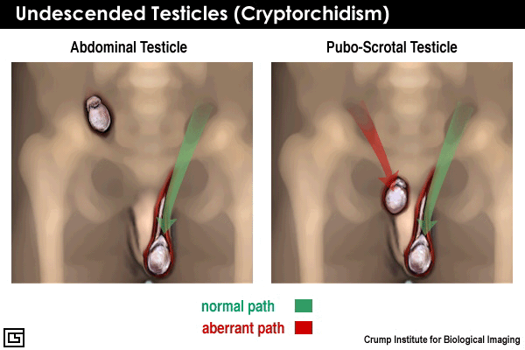
CRYPTORCHIDISM

Slide 27
LOCAL EXAMINATION
Hypospadias, abnormal curvature, phimosis -interfere with the proper deposition of sperm deep within the vagina.
An irregular epididymis - infection or obstruction.
Notes:
27

Slide 28
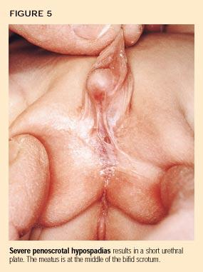
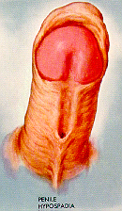
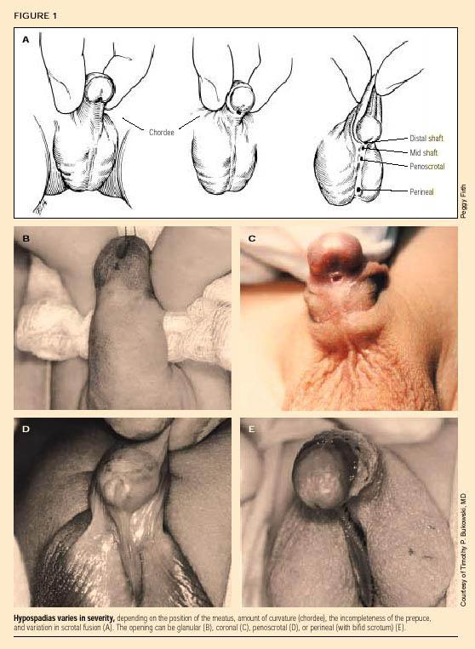
HYPOSPADIAS
From: Netter, F.H.,
The CIBA Collection
Courtesy:
Contemporary
Pediatrics® Archive
http://www.rnweb.com/be_core/content/journals/k/data/2001/0202/screen/k2a089f01.jpg
Courtesy: http://www.hypospadias.net/

Slide 29
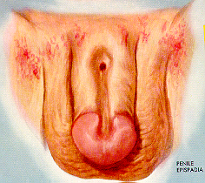
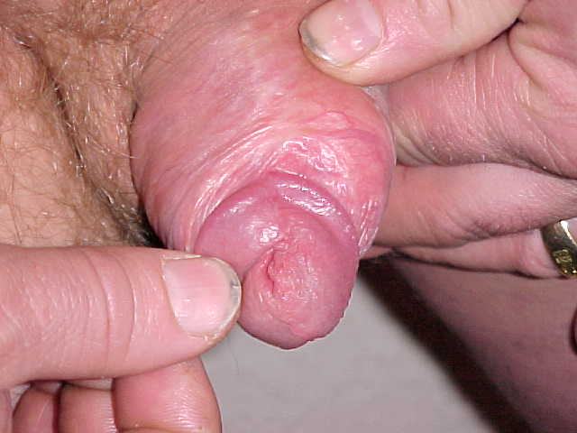
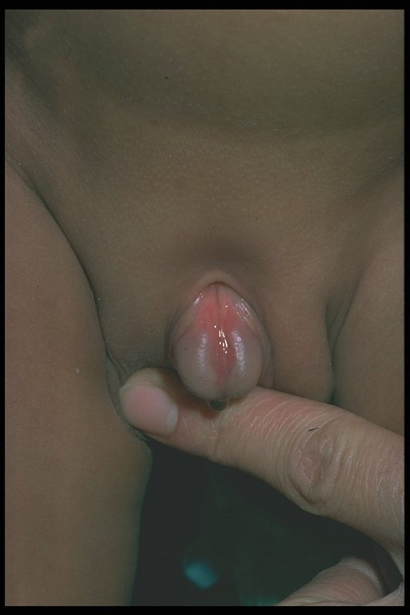
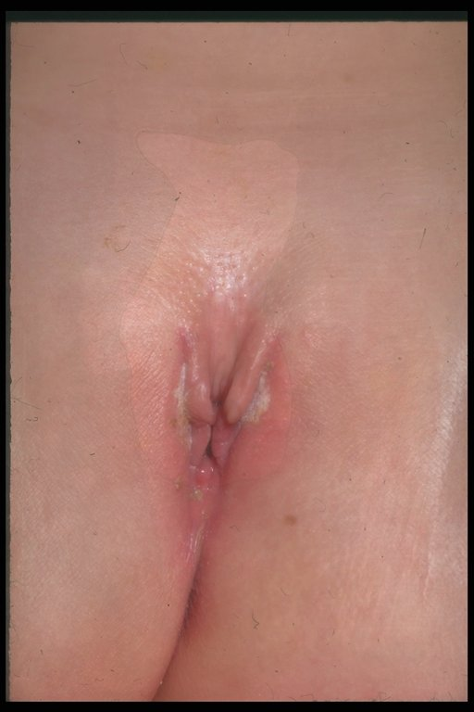
Un-repaired Adult Male
Courtesy of: http://www.epispadias-info.com/photos.html
From: Netter, F.H.,
The CIBA Collection
EPISPADIAS
MALE
infant
FEMALE infant
Infants Curtesy of: http://cai.md.chula.ac.th/lesson/atlas

Slide 30
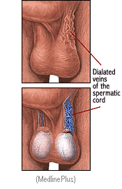
LOCAL EXAMINATION-VARICOCELE
Patient standing in a warm examination room
Valsalva maneuver
Small left testicle with a boggy, "bag-of-worms"-like mass surrounding the testicle - large varicocele.
A unilateral right-sided varicocele suggests venous thrombosis/tumor or situs inversus.
Notes:
30

Slide 31
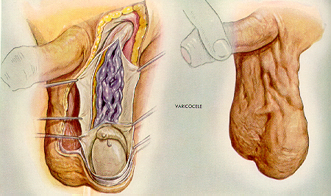
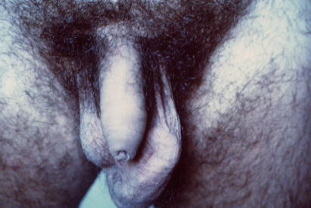
VARICOCELE
(incompetent veins along the spermatic cord)
Courtesy of:
Netter, F.H., The CIBA Collection &
Miguel F. da Cunha, Ph.D., The University of Texas – Houston Health Science Center
Courtesy of www.andrologia.lazio.it/varicocele.jpg

Slide 32
VARICOCELES
The incidence
  Adult male population - 20%
  Infertile population- 40%.
Bilateral varicoceles >40%.
50% - impaired semen quality
Many men with varicoceles are fertile.
Notes:
32

Slide 33
ABNORMAL SPERMATOGENESIS WITH VARICOCELE
Elevated testicular temperature due to venous stasis
Retrograde flow of toxic metabolites from the adrenal or kidney
Blood stagnation with germinal epithelial hypoxia
Alterations in the hypothalamic-pituitary-gonadal axis.
Notes:
33

Slide 34
ABSENCE OF THE SEMINAL VESICLES
Azoospermia
Semen does not coagulate at ejaculation
Absence of fructose
Notes:
34

Slide 35
PROSTATE EXAMINATION
Size - small - androgen deficiency
Tender and boggy - prostatitis.
Notes:
35

Slide 36
GENERAL EXAMINATION
Rule out any chronic or unsuspected systemic diseases that may impair testicular function.
Notes:
36

Slide 37
RENAL FAILURE WITH UREMIA
Decreased libido, impotence and altered spermatogenesis and gynecomastia.
Cause of hypogonadism - probably multifactorial.
LH and FSH - elevated and testosterone - decreased. Serum prolactin - elevated ,estrogen elevated.
Anti-hypertensive drugs and uremic neuropathy - role in uremic impotence and hypogonadism.
After successful renal transplantation, uremic hypogonadism improves
Notes:
37

Slide 38
CIRRHOSIS OF THE LIVER
Testicular atrophy, impotence and gynecomastia.
Testosterone levels are decreased.
Estradiol is increased - decreased hepatic extraction of androgens with increased conversion to estrogen peripherally.
LH and FSH levels - moderately elevated relative to the low serum testosterone levels.
Ethanol also acutely reduces testosterone levels by inhibiting testicular testosterone synthesis
Notes:
38

Slide 39
SICKLE CELL DISEASE
Hypogonadism.
LH and FSH levels – variable.
Testosterone levels - low.
Secondary to a mixture of testicular and pituitary-hypothalamic causes.
Notes:
39

Slide 40
INVESTIGATIONS
Notes:
40

Slide 41
Notes:
41

Slide 42
CAUTION
Laboratory analysis does not predict fertility
Pregnancy is the only irrefutable proof of the sperm's capability to fertilize.
Notes:
42

Slide 43
Male Clinical Evaluation
Adjunctive Procedures:
  Postcoital test
  Optimized Sperm Penetration Assay
  Testicular biopsy
  Antisperm antibody test

Slide 44
IMPORTANT
VOL< 2 ml-
  Incomplete collection
  Retrograde ejaculation
  Ejaculatory duct obstruction
  Androgen deficiency
VOL > 6 ML-
  Ac prostatitis
  Long abstinence
  Dilutional effect
Notes:
44

Slide 45
pH < 7.2
Ejaculatory duct obstruction
Congenital absence of the seminal vesicles and vas deferens
Infection
  Increased number of polymorphs
  Decreased motility
  Agglutination
Notes:
45

Slide 46
SEMEN COAGULATION
Semen from normal men coagulates and then over 20-30 plus minutes liquefies.
Delayed liquefaction > 60 minutes - disorders of accessory gland function.
If sperm are capable of reaching the cervical mucus, problems of semen liquefaction are not clinically relevant.
Notes:
46

Slide 47
SEMEN VISCOSITY
Increased semen viscosity, which is unrelated to the coagulation-liquefaction phenomenon, signifies a disorder of accessory gland function
Affects the accuracy of assessment of both sperm density and motility.
It is only clinically relevant when there are very few sperm in the post coital test
Notes:
47

Slide 48
MOTILITY
Single most important measure of semen quality and can be a compensatory factor in men with low sperm counts
Notes:
48

Slide 49

EVALUATION OF MORPHOLOGY. HUMAN SPERM
Hematoxylin and Eosin (H&E)
Morphology is routinely used as a measure of fertility status
Kruger’s strict criteria
Notes:
49

Slide 50
SPERM MORPHOLOGY
No longer is it felt that increased numbers of tapered, amorphous and immature cells (stress pattern) are pathonomic of varicoceles, but rather represent altered testicular function
Notes:
50

Slide 51
HAEMOSPERMIA
CYTOLOGY-MALIGNANT CELL
1% OF INFERTILE MALES
TRAUMATIC MASTURBATION
Notes:
51

Slide 52
ROUND CELLS
Difficult to differentiate between white blood cells and immature spermatozoa on routine analysis, - both appear as round cells in the semen
Peroxidase stain and monoclonal antibodies have been utilized to aid in this differentiation.
Excessive white cells ( > 1 million/cc) may indicate an infection that may contribute to subfertility.
Notes:
52

Slide 53

A. Light micrograph of a semen sample containing numerous round cells.
B. The same semen sample is shown after staining with a PEROXIDASE STAIN, which stains polymorphonuclear white blood cells.
Notes:
53

Slide 54
INFECTIONS
High concentrations of gram-negative bacteria like E-coli in the semen can impair sperm motility.
Sexually transmitted organisms such as chlamydia trichomatous, mycoplasma hominis and ureaplasma urealyticulum have rarely been implicated in reproductive failure.
There is no convincing evidence to support the use of routine cultures or empiric therapy in asymptomatic infertile males.
Notes:
54

Slide 55
AGGLUTINATION
Head-to-head, head-to-tail, or tail-to-tail - inflammatory or immunologic process
Head-to Head -- IgM
Tail to tail --IgG
Notes:
55

Slide 56
FRUCTOSE
Androgen-dependent and is produced in the seminal vesicles
Azoospermia- qualitative test for fructose performed.
Low ejaculate volume and lack of fructose, along with failure of the semen to coagulate- congenital absence of the vas deferens and seminal vesicles or obstruction of the ejaculatory ducts.
Notes:
56

Slide 57
SPERM ANTIBODIES
3-7% of infertile males
Immunity not an all-or-none phenomenon but may contribute to reduced fertility potential
Breakdown of the blood-testes barrier by infection, trauma or operation allows sensitization of the spermatozoa antigens.
Notes:
57

Slide 58
IMMUNOLOGIC STUDIES
ASA- reduce the likelihood of pregnancy ∝ concentration of ASA
Attach to the plasma membrane -Sperm agglutination
Abnormal post coital tests
Interfere with penetration and transit of sperm through cervical mucus
History compatible with disruption of the integrity of the genital tract
Found in circulation / in seminal plasma or directly on the sperm surface.
Notes:
58

Slide 59
THE IMMUNOBEAD BINDING TEST (IBT)
Most informative and specific to detect antisperm antibodies bound to the surface of sperm.
Humoral antibodies not relevant to fertility unless these are also present within the reproductive tract.
Notes:
59

Slide 60
HORMONAL EVALUATION
FSH,LH,TSH,TESTOSTERONE,PROLACTIN
Incidence - primary endocrine defects in infertile men is < 3%
Rare - sperm concentration is > 5 x 10⁶/mL
Hormone evaluation
  Low sperm concentration
  An endocrinopathy is suspected clinically.
LH secretion is episodic and has short half life-- a single LH determination has an accuracy of plus or minus 50%.
Testosterone is secreted episodically in response to LH pulses and has a diurnal pattern with an early morning peak.
Serum FSH has a longer half life, and these fluctuations are less obvious.
Notes:
60

Slide 61
A ↑↑ serum FSH - azoospermia or severe oligospermia, difficult-to-treat germ cell defect (primary testicular failure).
A ↓↓ FSH - hypogonadotropic hypogonadism
  Undermasculinization
  ↓Serum testosterone and luteinizing hormone (LH).
  A year of hormone therapy before optimal sperm production is reached
Notes:
61

Slide 62
HYPOGONADOTROPIC HYPOGONADISM
Assess ACTH, TSH, and GH.
Thyroid dysfunction - rare cause of infertility routine screening - discouraged.
Notes:
62

Slide 63
HYPERPROLACTINEMIA
Oligospermia
↓ Testosterone level without an associated ↑ in LH.
↓ libido.
↓ ejaculate volume.
Galactorrhea.
Notes:
63

Slide 64
Clinical Status | FSH (mIU/mL) | LH (mIU/mL) | Testosterone (ng/100 mL)
Normal men | Normal | Normal | Normal
Germinal aplasia | ↑ | Normal | Normal or ↓
Testicular failure | ↑ | ↑ | Normal or ↓
Hypogonadotropic hypogonadism | ↓ | ↓ | ↓
Hypergonadotropic hypogonadism | ↑ | ↑ | Low-normal or ↓
Notes:
64

Slide 65

SCANNING ELECTRON MICROGRAPH (SEM) OF A ROUND-HEADED SPERM CELL.
Lack of the sperm acrosome, necessary for normal fertilization, which is consistent with round-headed sperm.
Notes:
65

Slide 66

TRANSMISSION ELECTRON MICROGRAPH (TEM) OF A ROUND-HEADED SPERM.
Incomplete condensation of chromatin
Remnants of the cytoplasm.
Absent acrosome
Abnormal midpiece.
Notes:
66

Slide 67

Transmission electron micrograph of cross sections of tail
The 9+2 microtubule pattern is abnormal in the lower two cross-sections, and precludes normal sperm motility.
Notes:
67

Slide 68
SPERM FUNCTION TESTS
Zona free hamster egg penetration assay
The DNA stability assay
HOS TEST
Notes:
68

Slide 69

Zona free hamster –sperm penetration assay
Measure the ability of a patient’s sperm to undergo capacitation and penetration of an egg.
Predicts the ability of the patient’s sperm to fertilize human eggs.
Penetrating sperm - swelling of the sperm head which occurs after penetration.
Notes:
69

Slide 70
DNA STABILITY ASSAY
Sperm DNA stressed thermally or chemically, stained with acridine orange.
  Double stranded DNA - stained green
  Single stranded DNA - stained red
Increased single stranded DNA -genetic damage
Notes:
70

Slide 71

Acridine Orange staining
Green sperm heads DNA
Yellow to Red sperm heads - damage to DNA.
Notes:
71

Slide 72
HYPO-OSMOTIC SWELLING
33-80% of the spermatozoa exhibit tail swelling on exposure to fructose and sodium citrate solution - osmosis.
Non viable or sperm with non-functioning membranes do not swell.
Samples with > 62% swelling are able to fertilize ova, whereas < 60% swelling is observed in samples of infertile semen.
Notes:
72

Slide 73
CHROMOSOMAL STUDIES
(SEX CHROMOSOMAL)
INDICATION
  Men with severe oligospermia or azoospermia
Incidence of male chromosome abnormalities -6.2%.
Sperm count <10 million- 11%.
Azoospermia - 21%
Rarely infertility associated with a specific chromosomal abnormality i.e. D-D translocations, ring abnormalities, reciprocal translocation, and various other aberrations
Notes:
73

Slide 74
Klinefelter's Syndrome
Classic form - 47,XXY
Mosaic form 46,XY/47,XXY- 10%
Incidence - 1:500 males
Small, firm testes, delayed sexual maturation, azoospermia and gynecomastia
Hypogonadism not evident until puberty- diagnosis is delayed.
Notes:
74

Slide 75
Klinefelter's Syndrome
Sclerosis and hyalinization of the seminiferous tubules
LH and FSH levels - elevated
Testosterone levels - normal to low and decrease with age
Serum estradiol levels increased - gynecomastia
Mosaics - less severe features of Klinefelter's Syndrome and may be fertile - normal clone of the cells within the testes
Mild mental deficiency and restrictive pulmonary disease
The infertility is reversible
Later in life require androgen replacement therapy for optimal virilization and normal sexual function
Notes:
75

Slide 76
XX Disorder or Sex Reversal Syndrome
Variant of Klinefelter's Syndrome
The signs are similar, except
  Average height is less than normal
  Hypospadias is common
  Decreased incidence of mental deficiency
These patients have a 46,XX chromosome complement
  Cells express H-Y antigen and are presumed to have a Y chromosome somewhere in their genomes
Notes:
76

Slide 77
XYY syndrome
Incidence same as Klinefelter's Syndrome
Phenotypic expression is more variable.
Semen - azoospermic to normal.
Excessively tall and have had pustule acne.
Anti-social behavior.
Normal LH and testosterone level with the FSH level dependent on the extent of germ cell damage.
No treatment for infertility.
Notes:
77

Slide 78
Noonan's Syndrome
Male counterpart of Turner's Syndrome (X0)
Short stature, web neck, low-head ears, cubitus valgus, ocular abnormalities and cardiovascular abnormalities.
Cryptorchidism and diminished spermatogenesis - infertile. Those with diminished testicular function will have elevated serum FSH and LH levels.
Chromosomal analysis X0/XY mosaicism.
No treatment for infertility.
Notes:
78

Slide 79
MYOTONIC DYSTROPHY
Delayed muscle relaxation after initial contraction.
Lenticular opacities, frontal baldness and testicular atrophy.
Autosomal dominant and the expression is variable though 80% will develop testicular atrophy.
Pubertal development normal and testicular damage later in adult life.
Leydig cell function normal and no gynecomastia
Notes:
79

Slide 80
BILATERAL ANORCHIA OR VANISHING TESTES SYNDROME
1 in 20,000 males
Non-palpable testes at birth and sexual immaturity later in life - absence of testicular androgens
Normal karyotype
Elevated LH and FSH levels, extremely low testosterone
In utero - testes lost due to torsion, trauma, vascular injury or infection
Notes:
80

Slide 81
BILATERAL ANORCHIA OR VANISHING TESTES SYNDROME
Functioning testicular tissue present in first trimester of fetal life in order for the male reproductive ducts and for the external genitalia to differentiate along male lines.
Testosterone does not increase in response to HCG stimulation.
Eunuchoid proportions but no gynecomastia.
Therapy can only be directed at the testosterone deficiency.
Notes:
81

Slide 82
CONGENITAL ABSENCE OF THE VASA AND SEMINAL VESICLES
2% of infertile men.
Low ejaculate volume and azoospermia.
60% of CBAVD males - cystic fibrosis mutation, testing the female is critical when the male is a carrier.
Both partners carriers- preimplantation genetic study
Notes:
82

Slide 83
IMMOTILE CILIA SYNDROME
Infertility with recurrent respiratory infections
Kartagener's syndrome----
  Absent dynein arms
  Short or absent spokes with no central sheath
  Missing central microtubules
Young's Syndrome----
  Ultrastructure of the cilia is normal
  Epididymis obstructed – inspissated material
  Azoospermia
Deficiency of the protein carboxylmethylase in the tail of the sperm.---Affects motility
Notes:
83

Slide 84
ANDROGEN RESISTANCE
Under masculinization and infertility
Normal external genitalia
Abnormal androgen receptors in a culture of genital skin fiberblasts
Elevated testosterone and LH levels
No treatment for their infertility
Notes:
84

Slide 85
ROLE OF TESTICULAR BIOPSY
Size normal, FSH/LH normal-OBSTRUCTIVE PATHOLOGY.
Size small,FSH/LH raised- TESTICULAR ATROPHY
Blood testes barrier
Bouin's or Zenker's solution. Formalin should be avoided as it distorts the testicular architecture.
INDICATION OF BIOPSY
  Malignancy/tuberculosis/syphilitic gumma
  Azoospermia and severe oligospermia with normal FSH levels
Notes:
85

Slide 86
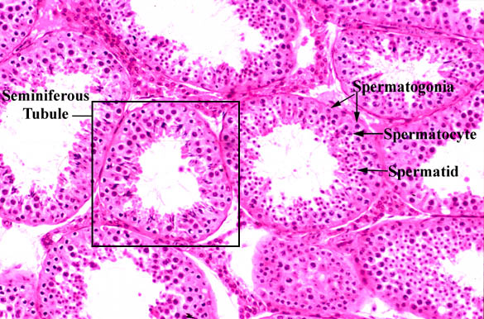
Notes:
86

Slide 87
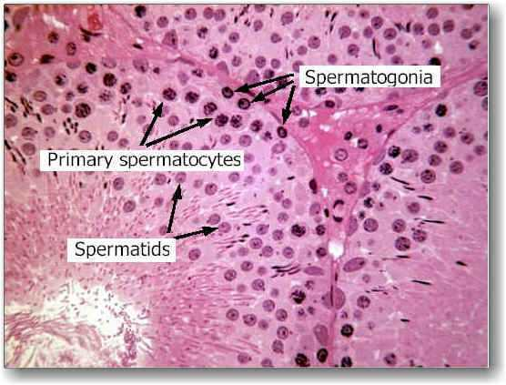
Notes:
87

Slide 88
SERTOLI-CELL-ONLY SYNDROME
CAUSE
  Congenital absence of the germ cells
  Genetic defects
  Androgen resistance.
CLINICAL FEATURES
  Testicular biopsy - complete absence of germinal elements
  Azoospermia in association with normal virilization
  Testes of normal consistency but slightly smaller in size, no gynecomastia
  Normal Testosterone and LH levels , elevated FSH levels
Notes:
88

Slide 89
SERTOLI-CELL-ONLY SYNDROME
D/D :
  Mumps, cryptorchidism or radiation/toxin damage
    Seminiferous tubules may also contain only Sertoli cells,
    Testes are small
    Histologic pattern - not as uniform.
    Severe sclerosis and hyalinization as prominent features.
No treatment for their infertility
Notes:
89

Slide 90
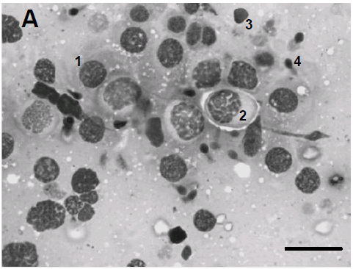
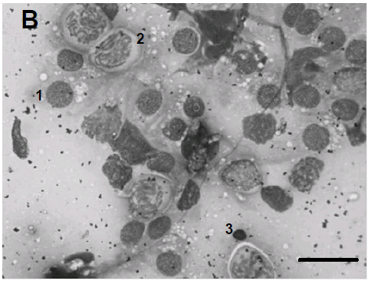
Photomicrographs of fine needle aspiration cytology (FNAC) slides in persons with normal spermatogenesis (A) and in patients with maturation arrest (B). Representative cells at different stages of spermatogenesis are indicated by numericals in both A and B. 1- Spermatogonia; 2-Spermatocyte; 3-Spermatid and 4-Spermatozoa. In (B) note the absence of spermatozoa. Horizontal bar= 25 μ .
?
Notes:
90

Slide 91
Vasography
Invasive technique requires exploration of vas in scrotum.
Mainly indicated in men with azoospermia with testicular biopsy showing normal spermatogenesis.
CDU has now replaced it as the primary imaging technique for imaging distal ductal system.
Notes:
91

Slide 92
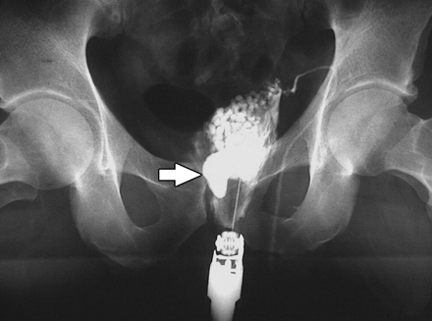
Endorectal seminal vasography (or vesiculography) in 42-year-old man with infertility. This study shows periprostatic structure & dilated ejaculatory duct (arrow) upstream from obstruction of entrance of ejaculatory duct into prostatic urethra. Injection of contrast material under endorectal sonographic guidance both opacifies dilated obstructed duct and confirms that it is obstructed, because contrast material does not pass into prostatic urethra.
Notes:
92

Slide 93
Unfortunately, at least 25-40% of infertile men have idiopathic infertility for which no cause can be identified.
More known causes will be discovered hopefully as knowledge of male reproductive physiology expands.
Notes:
93

Slide 94
TREATMENT OPTIONS
Timed intercourse
IUI- > 10 Million/ml
IVF-ET – 5-10 Million/ml
ICSI- < 5 Million/ml
    Surgically retrieved spermatozoa
Donor insemination
Notes:
94

Slide 95
Medical management
Hypogonadotrophic Hypogonadism
HMG+HCG,Dopamine agonist
Eugonadotrophic Hypogonadism
Severe oligospermia,low T,Low T/E ratio will benefit from aromatase inhibitor : letrozole
Hypergonadotrophic Hypogonadism
Gamete donation,counseling followed by ICSI
Notes:
95

Slide 96
Medical management
INFECTION /LEUCOCYTOSPERMIA MALE ACCESSORY GLAND INFECTION
Individuals with symptomatic or documented genitourinary tract infection should be treated with the appropriate antibiotics.
Doxycycline is often the first drug of choice.
Notes:
96

Slide 97
Medical management
RETROGRADE EJACULATION
Alpha mimetic drugs(Imipramine 25 mg BD)
Alkalinize urine.(Sodium bicarbonate)
IUI/ICSI can be done.
Notes:
97

Slide 98
Medical management
SEXUAL AND EJACULATORY DYSFUNCTION
Counseling
5 Phospho-Di-estrase inhibitors
Notes:
98

Slide 99
Medical management
Idiopathic oligospermia, Asthenospermia,and Terato-spermia
Androgens
Gonadotrophins
Antiestrogens
Notes:
99

Slide 100
Medical management
IMMUNOLOGICAL CAUSES
IUI
Prednisolone
Notes:
100

Slide 101
Vibratory stimulation and Electro-Ejaculation
Neurological conditions effecting sympathetic system
(spinal cord injuries,demelinating neuropathies, diabetes)
IUI,IVF-ICSI can be done.
Notes:
101

Slide 102
SURGICAL MANAGEMENT
Notes:
102

Slide 103
CONGENITAL CAUSES
Undescended testes : Orchidoplexy
Phimosis
Hypospadiasis
Notes:
103

Slide 104
TREATMENT SUCCESS AFTER SURGICAL REPAIR
STATISTICS COURTESY OF : Miguel F. da Cunha, Ph.D.
The University of Texas - Houston
Health Science Center
Varicocele repair
  Probability of semen improvement 25-50%
  Probability of pregnancy:50-70%
Vasoepididymostomy
  Patency rates: 60-70%
  Probability of pregnancy: >30%
Vasovasostomy
  Overall pregnancy rate: 50-60%

Slide 105
TREATMENT OUTCOMES
with ejaculatory problems
Ejaculatory disorders:
  Sympathomimetic drugs: 20-30%
Retrograde ejaculation:
  Sperm rescue from urine: variable success rate
Antisperm antibody:
  Immunosuppressive drugs: variable success

Slide 106
Chromosomal abnormalities
Klinefelter's syndrome:
Mosaic variants
Y-chromosome deletions
ICSI WITH TESTICULAR SPERMS CAN BE DONE
Notes:
106

Slide 107
VARICOCELE
Varicocelectomy
Retroperitoneal,inguinal,subinguinal,laparoscopic
Embolization
Corrects over 90% of cases
Rest can be offered IUI,IVF
Notes:
107

Slide 108
AZOOSPERMIA
Notes:
108

Slide 109
Testicular biopsy
Performed mainly to differentiate primary testicular failure from obstructive ductal lesions in azoospermic patients.
As the testicular tissues are being examined directly, it remains the gold standard for judging testicular function.
If there are indications of ductal obstruction or testicular failure, both testes should be biopsied as both have different degrees of dysfunction.
The argument in favor of unilateral biopsy is that the opposite testes is completely untouched to obviate adhesions or fibrosis.
Can be performed by open method using window technique or by FNAC.
Notes:
109

Slide 110
Management of Azoospermia man
Surgical
Micro -Surgical reconstruction
Vaso-epididymostomy
Vasovasotomy
Sperm retrieval techniques
Notes:
110

Slide 111
Assisted Reproduction- Newer Methods
Sperm aspiration
A procedure to obtain sperms from male reproductive tract.
Indications are severe form of male infertility cause by obstructive and non-obstructive azoospermia, also in patients with severely impaired or almost non-
existent sperm production – necrospermia.
Sites of sperm aspiration –
Testes
Upper epididymis
Lower epididymis
Vas
Notes:
111

Slide 112
Assisted Reproduction- Newer Methods
Microsurgical Epididymal Sperm Aspiration (MESA)
Microsurgical technique to obtain sperms from epididymis in cases of
obstructive azoospermia
Indications –
Congenital absence of vas
Bilateral non-constructible ejaculatory duct obstruction
Obstructive azoospermia following radical prostatectomy and radical Cystectomy.
Failed vasoepididymostomy.
Notes:
112

Slide 113
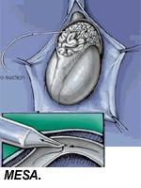
Microsurgical Epididimal Sperm Aspiration (MESA)
Notes:
113

Slide 114
Assisted reproduction- Newer methods
Percutaneous Epididymal Sperm Aspiration (PESA)
Simple, convenient and inexpensive
Sperms are sucked from epididymis after puncturing it with a fine No 6 needle.
Advantages – less expensive
Disadvantages – blind procedure
accidental injury to blood vessels and hematoma formation
amount of sperms obtained is less
Testicular sperm aspiration (TESA)
Involves sucking out testicular tissue with a fine needle under local LA.
Notes:
114

Slide 115
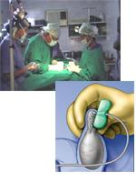
Percutaneous Ependymal Sperm Extraction
(PESA)
Notes:
115

Slide 116
Assisted reproduction- Newer methods
Testicular Sperm Extraction (TESE)
It is an open procedure performed under mild sedation and direct vision thus
minimizing the complications.
Advantages –
TESE is procedure of choice for men with non obstructive azoospermia
Performed under LA in office procedure room
Open biopsy TESE is more effective than needle biopsy TESE. It is the second best way to collect sperms.
Sperms harvested using TESE can be stored for future use.
Disadvantages –
Amount of sperms obtained is less than MESA
Many andrology labs find it difficult to work with TESA sperms.
Notes:
116

Slide 117
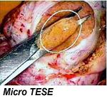
Testicular sperm extraction (TESE)
Notes:
117

Slide 118
Which is better
Microsurgical
techniques
Obstructive interval is less than 15 years.
No female factors are associated.
In case of Epididymal obstruction the decision
Should be individualized.
Sperm retrieval
Advanced female age.
Concomitant female factors.
Poor out come expected by surgical techniques.
Notes:
118

Slide 119
Sperm retrieval techniques
 | Epididymal | Testicular
Open biopsy | MESA Semen are highly concentrated in epididymus (1x10 (6) sperm/micro l. thus only few micro l of fluid extracted. | Open testicular biopsy TESE
Percutaneous | PESA PESE | Perc biopsy 14 gauge biopsy gun FNA/TESA
Notes:
119

Slide 120
EMPIRICAL TREATMENT
Clomiphene
L-Carnitine
Coenzyme Q 10
Arginine
Vit E
Sellenium
Notes:
120

Slide 121
NEW ADVANCES
Derivation of embryonic germ cells and male gametes from embryonic stem cells.
  Geijsen N, Horoschak M, Kim K, Gribnau J, Eggan K, Daley GQ. Nature. 2004 Jan 8;427(6970):148-54. Epub 2003 Dec 10.
Notes:
121

Slide 122



Sperm morphology
Biological functionality
EB derived cells have
similar morphology to testis derived haploid cells. Round spermatids?
• ICSI with haploid cells into recipient
oocytes
• 50% of the embryos cleaved to 2 cell stage
• 20% reach the blastocyst stage.
• FISH: normal for sex chromosomes
Notes:
122

Slide 123
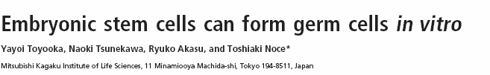

Notes:
123

Slide 124
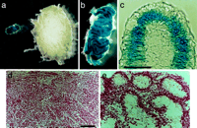
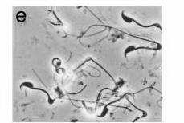
Germ cell in vivo production from mESC.
• Transplantation of ESC aggregates to
testicular capsule.
• ESC derived cells can participate in
spermatogenesis and produce functional
germ cells in vitro
Notes:
124

Slide 125
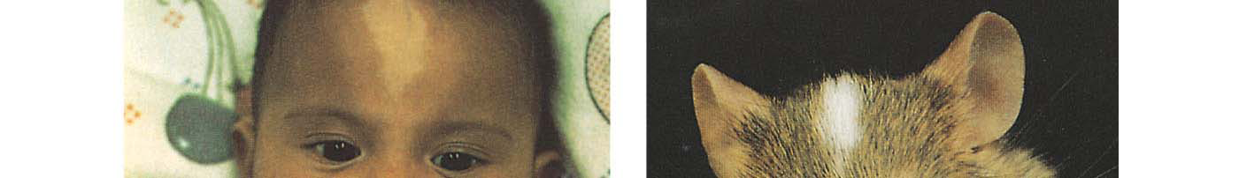
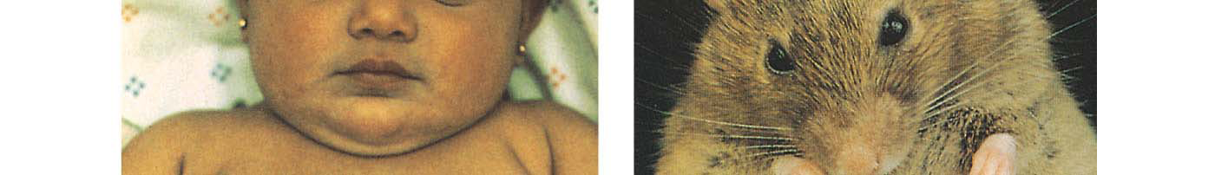
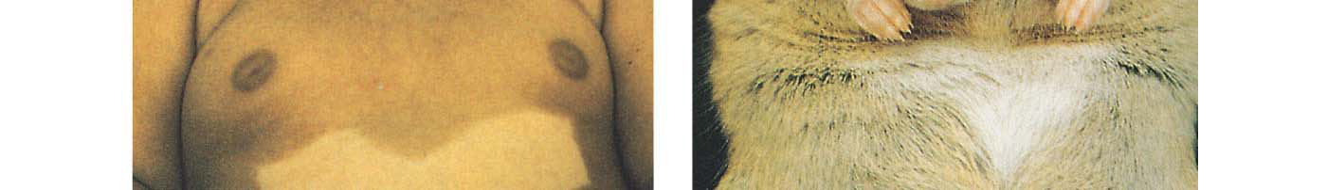
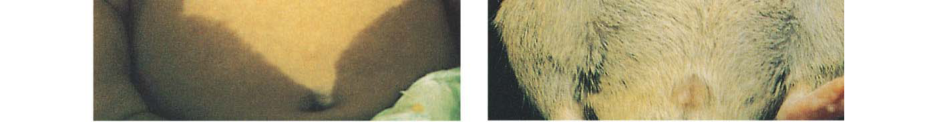
Notes:
125

Slide 126

Nayernia et al, Developmental Cell 11, 125-132, July 2006
Notes:
126

Slide 127
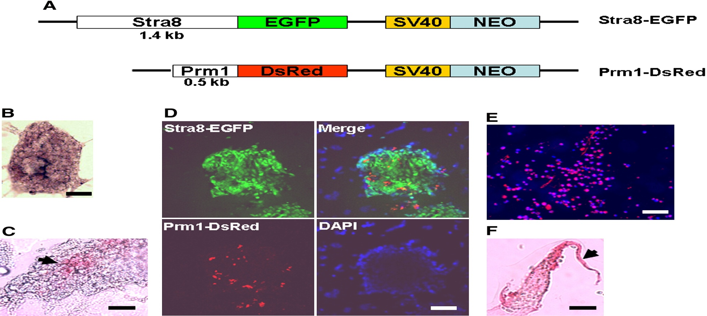
Establishment of two cell lines (Spermatogonial stem cells- SSCs) with patterns of differentiation towards male germ cells .
• Derived from mESC (directed gene expression for premeiotic and haploid male germ cells)
• Motility of cells
• Formation of tail-like structures
Notes:
127

Slide 128
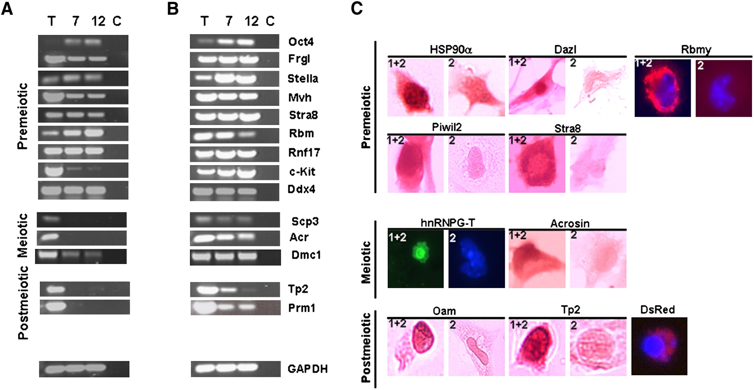
Positive for PGCs premeiotic (Oct 4,Fragilis, Stella,..),,meiotic (Scp3, Acr) and postmeiotic male germ cells markers
• Formation of sperm structures.
• Acrosome like structures
• Condensation of the nucleus
Notes:
128

Slide 129
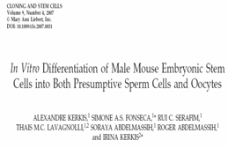
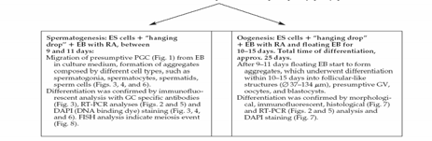
Notes:
129

Slide 130
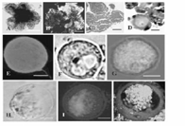
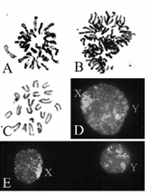
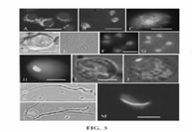
Female GC differentiation
Reduction in chromosome number
Male GC differentiation
Kerkis et al, 2008
Notes:
130

Slide 131
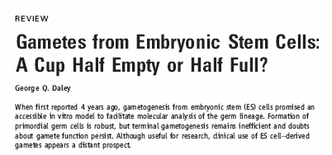
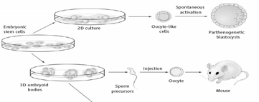
Notes:
131

Slide 132
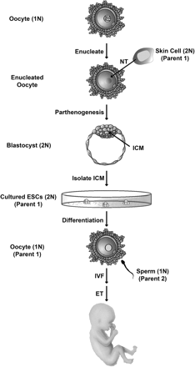
Customised gamete
derivation by Nuclear
Transfer
Notes:
132

Slide 133

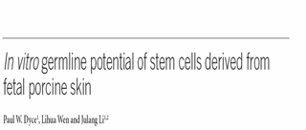
Notes:
133

Slide 134
Derivation of male germ cells from bone marrow stem cells
Somatic stem cells have a more flexible potential than expected, whether put into tissue or cultured under different conditions
Bone marrow (BM)-derived stem cells can transdifferentiate into multilineage cells, such as muscle of mesoderm, lung and liver of endoderm, and brain and skin of ectoderm origin
BM stem cells are able to transdifferentiate into male germ cells.
BMS cell-derived germ cells expressed the known molecular markers of primordial germ cells, such as fragilis, stella, Rnf17, Mvh and Oct4; as well as molecular markers of spermatogonial stem cells and spermatogonia including Rbm, c-Kit, Tex18, Stra8, Piwil2, Dazl, Hsp90, 1- and 6-integrins.
    Karim Nayernia¹et al. Laboratory Investigation (2006) 86, 654–663
Notes:
134

Slide 135
CONCLUSION
Notes:
135

